Slide 1
Effect of Correlations on Noisy states (Using Noisy states for some good)

Slide 2
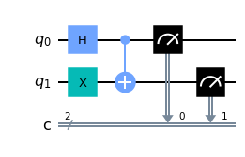
A study of following states(on ibmq_lima)-
1. (Bell’s state)

Slide 3
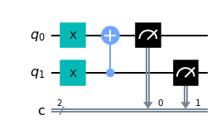
A study of following states(on ibmq_lima)- 1. (Bell’s state)
2. |01> (Separable state)

Slide 4

A study of following states(on ibmq_lima)- 1. (Bell’s state)
2. |01> (Separable state)
3. |10> (Separable state)

Slide 5

We plot curves for two error states |00> and |11> for the (Bell’s state)
and we compare it with two separable states

Slide 6
We plot curves for two error states |00> and |11> for the (Bell’s state)
and we compare it with two separable states |01>
|10>

Slide 7
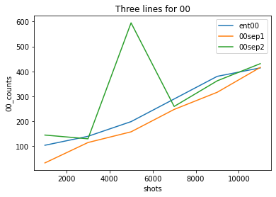
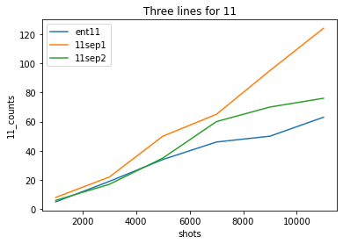
We plot curves for two error states |00> and |11> for the (Bell’s state)
and we compare it with two separable states |01>
|10>

Slide 8
Observation : The error state |11>(graph-1) clearly depicts less error count for the entangled Bell’s state.

Slide 9
Observation : The error state |11>(graph-1) clearly depicts less error count for the entangled Bell’s state.
Explanation- The less error count for bell’s state could be due to presence of entanglement in bell’s state which is not found in other two separable states.

Slide 10
Observation1 : No conclusive predictions can be made by looking at curves(graph-2) for error state |00>, so we can assume the error state |00> provides no conclusive evidence for entangled state out of three quantum states.

Slide 11
A study of following states()- Ibmq_lima
1. (|00>+|11>) x |0> (Bi-separable)
2. (|00>+|11>) x |1> (Bi-separable2)
3. |000> (separable)
4. |111> (separable)
5. |000>+|111> (GHZ)

Slide 12
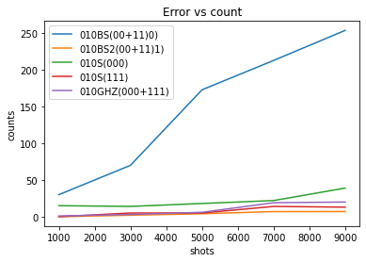
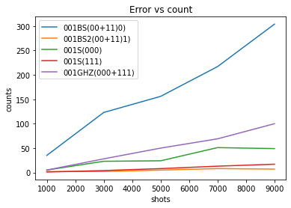
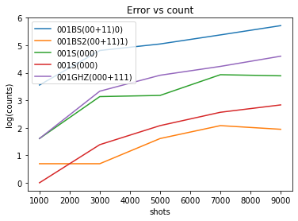
Final Conclusion
Looking at the given experimental data we can see that entanglement in the GHZ state does seem to prevent noisy states.

Slide 13
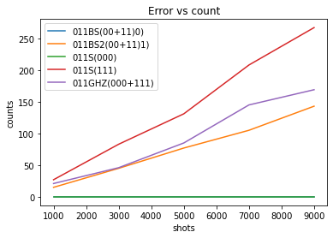
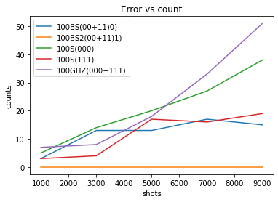
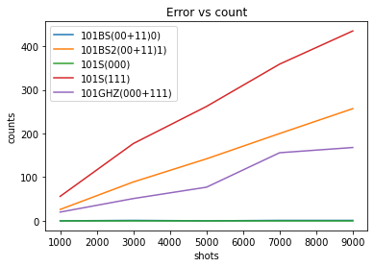
However the instability of |111> state leads to more error counts for states(110,011,101)(double 1’s). So a good distinction between a bi-separable state and GHZ should be to look at noisy states (100, 010, 001)(single 1’s).

Slide 14
Experiments that didn’t produce desired results
The collection of data for Bell’s state |00>+|11>) doesn’t seem to work out possible differences in error states between Bell’s state and other separable states. The reason is mostly due to unequal stability of |00> and |11>), which leads to unequal proportions of errors contributed by 00 and 11 portion of the Bell’s state.
It is not possible to distinguish between states of form a|00> +b|11> (from bell’s state) or C |000> + D |111>(from GHz states) just by just looking at the noisy states since there is no evident pattern and again the graphs mostly depend on unequal stability of |00> and |11>) (in a|00> +b|11> ) or unequal stability of
|000> and |111> ( in C |000> + D |111>)

Slide 15
Decoherence Effects
In Addition, here we model how decoherence affects entanglement of the bell states using the information we have about the quantum device.
(assuming that the qubit is found initially in the pure qubit state and interacts with its environment bath)

Slide 16
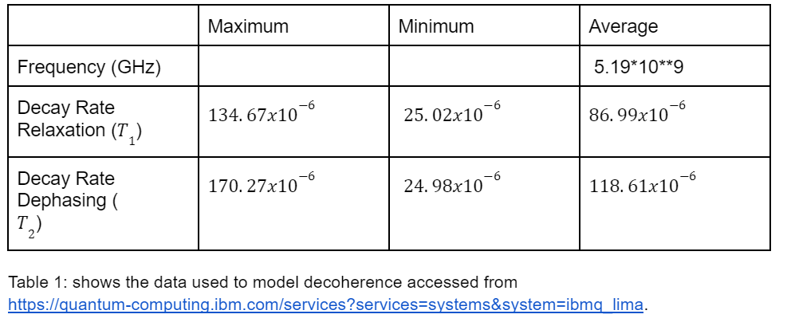
Decoherence Effects
In Addition, here we model how decoherence affects entanglement of the bell states using the information we have about the quantum device.
(assuming that the qubit is found initially in the pure qubit state and interacts with its environment bath)

Slide 17
Decoherence Effects
Hamiltonian is assumed and scaled for 2 Qubits is
Using Lindblad’s master equation in weak coupling regime.

Slide 18
Decoherence Effects
Hamiltonian is assumed and scaled for 2 Qubits is
Using Lindblad’s master equation in weak coupling regime.

Slide 19
This Figure demonstrates that the qubit becomes more mixed as it interacts with the environment, but that when it equilibrates with the environment

